Slide 1

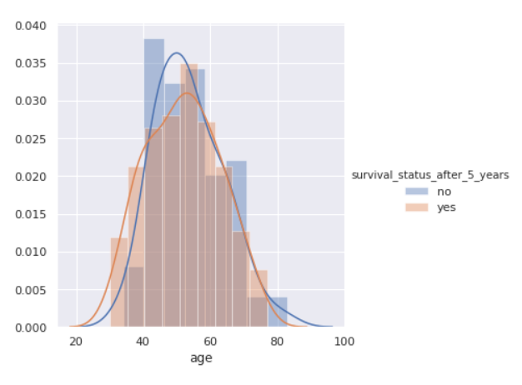
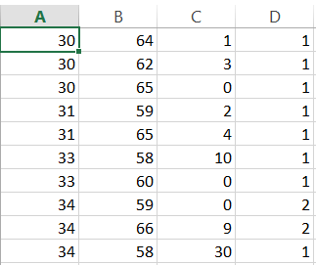
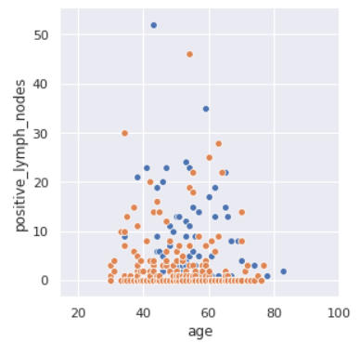
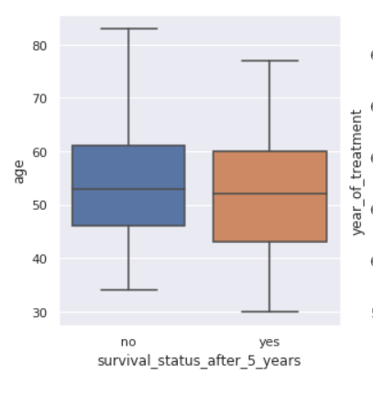
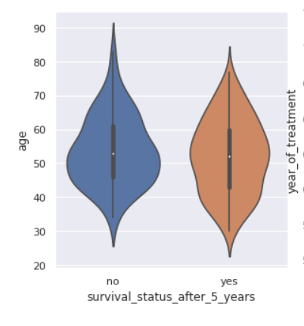
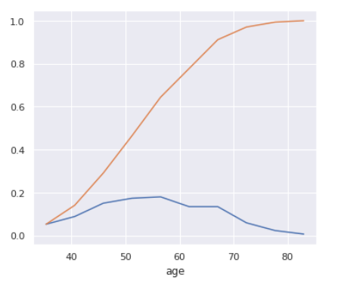
A Poster Presentation of IPE-205 on
“ Haberman’s survival : Exploratory Data Analy f7f288”
Distribution Plot
DATASET
Summary of the Poster:
The poster is on Haberman’s survival-Exploratory Data Analysis. It represents some statistical graphical figures on this dataset. It has 306 rows and 4 columns.
Scatter Plot
Submitted to:
Tanmoy Das
Code
# check for the input dataset
import os
print(os.listdir('../input'))
# import necessary packages
import numpy as np
import pandas as pd
import matplotlib.pyplot as plt
import seaborn as sns
sns.set()
# load the dataset
cancer_df = pd.read_csv('../input/haberman.csv', header=None, names=['age', 'year_of_treatment', 'positive_lymph_nodes', 'survival_status_after_5_years'])
print(cancer_df.head())
print(cancer_df.info())
Box Plot
Violin Plot
Submitted by:
MD. Tanzil Islam
Roll: 201736021
Fahim Montasir
Roll: 201736022
Syed Musfiqur Rahman
Roll: 201736047
Nahian Ibteda
Roll: 201736027
fig, axes = plt.subplots(1, 3, figsize=(15, 5))
for idx, feature in enumerate(list(cancer_df.columns)[:-1]):
sns.violinplot( x='survival_status_after_5_years', y=feature, data=cancer_df, ax=axes[idx])
plt.show()
# modify the target column values to be meaningful as well as categorical
cancer_df['survival_status_after_5_years'] = cancer_df['survival_status_after_5_years'].map({1:"yes", 2:"no"})
cancer_df['survival_status_after_5_years'] = cancer_df['survival_status_after_5_years'].astype('category')
print(cancer_df.head())
for idx, feature in enumerate(list(cancer_df.columns)[:-1]):
fg = sns.FacetGrid(cancer_df, hue='survival_status_after_5_years', size=5)
fg.map(sns.distplot, feature).add_legend()
plt.show()
Graphical Representation
Pair plot in seaborn plots the scatter plot between every two data columns in a given dataframe.
It is used to visualize the relationship between two variables
"""
sns.pairplot(cancer_df, hue='survival_status_after_5_years', size=4)
plt.show()
Kaggle link: https://www.kaggle.com/tanzilislam021/haberman-s-survival-exploratory-data-analy-f7f288/edit
Github link: https://github.com/mdtanzilislam/poster_presentation
# print the unique valuesof the target column
print(list(cancer_df['survival_status_after_5_years'].unique()))

